Slide 1
Analog Reflector
Installation and Basic Setup

Slide 2
How to Install on existing Debian Based System (ARM, i386, and AMD64)
Prerequisites: DVSwitch
Install the DVSwitch repository:
As root
cd /tmp
wget http://dvswitch.org/bustersudo chmod +x buster
sudo ./buster
sudo apt-get update
sudo apt-get install dvswitch-server

Slide 3
Configure Newly Installed DVSwitch
Setup MMDVM_Bridge
Open MMDVM_Bridge.ini in your favorite text editor either via ssh or if you are like me, I prefer to use WINSCP and then open in Notepad++
Located in /opt/MMDVM_Bridge/
Set DMR ID +2Digit number ex: 123456701 USE YOUR OWN
Make sure both frequencies are identical as shown
[DMR Network] Stanza has a password, I am on Brandmeister mostly so if that’s the case, use your Self-Care Hostpot password.

Slide 4
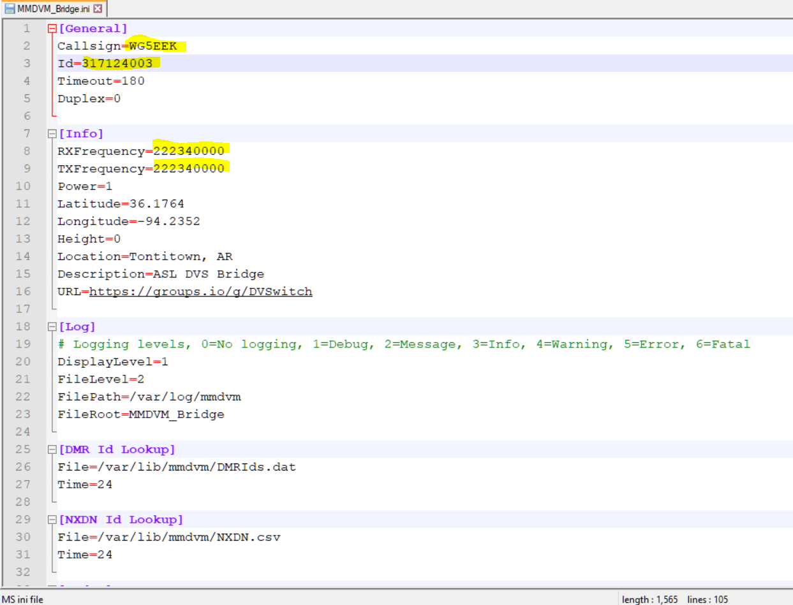

Slide 5
Brandmeister USA Servers

Slide 6
Configure Newly Installed DVSwitch cont.
Setup Analog_Bridge
Open Analog_Bridge.ini
Located in /opt/Analog_Bridge/
Set DMR ID and DMRID +2Digit number ex: 1234567 123456701 USE YOUR OWN
This assumes you do not have a USB AMBE3000 Stick or Server so check the other highlighted areas.

Slide 7
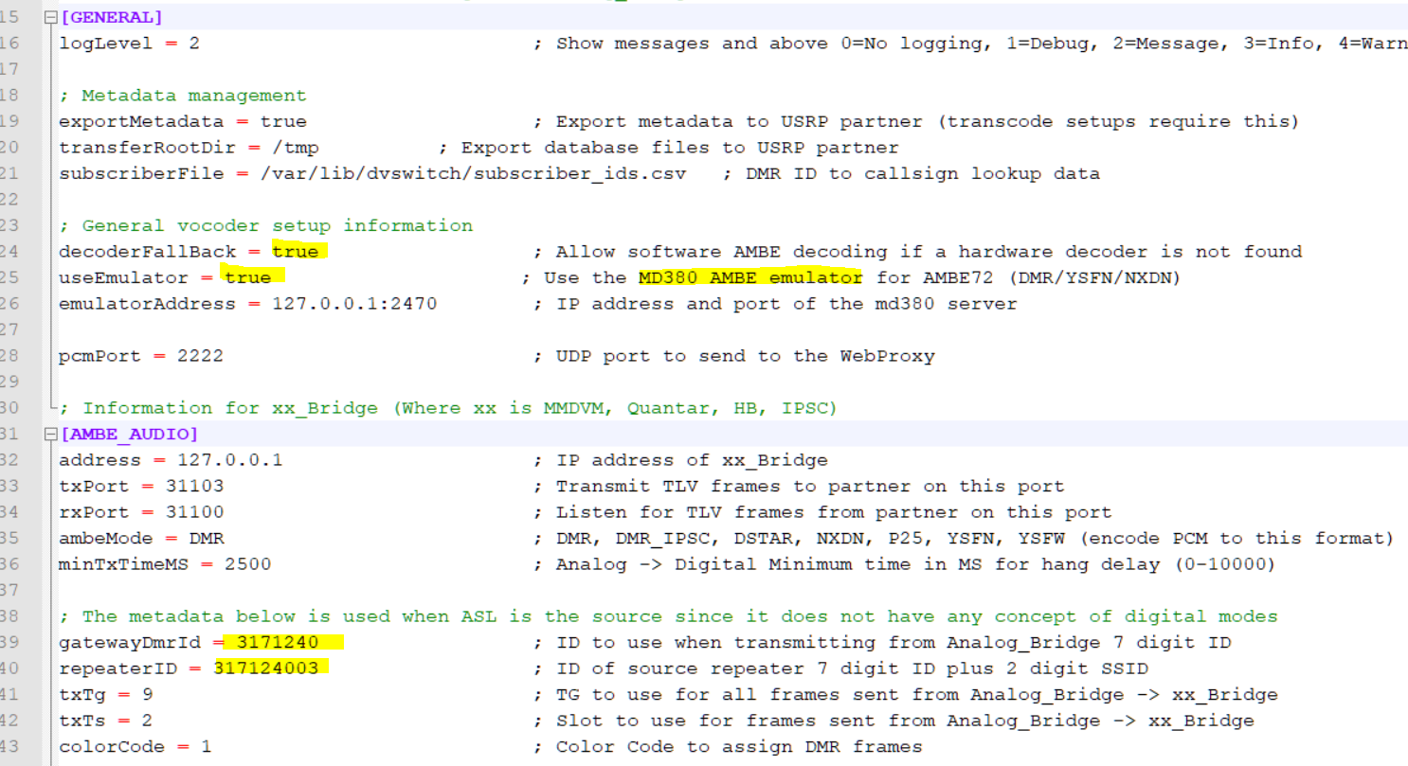

Slide 9
Configure Newly Installed DVSwitch Final
Run these commands
systemctl enable mmdvm_bridge
systemctl start mmdvm_bridge
systemctl enable analog_bridge
systemctl start analog_bridge
systemctl enable md380-emu
systemctl start md380-emu

Slide 10
Analog_Reflector Install and Setup
apt update
apt upgrade
apt install analog-reflector
cd /opt/Analog_Reflector
cd ssl
./mkcerts.sh
Once mkcert completes, you have a self signed certificate for your host
cd /opt/Analog_Reflector
./Analog_Reflector user WG5EEK 3171240 317124003 password 11
systemctl enable analog_reflector
systemctl start analog_reflector
Point your browser at the server https://192.168.x.y and then enter your callsign and newly created password

Slide 11
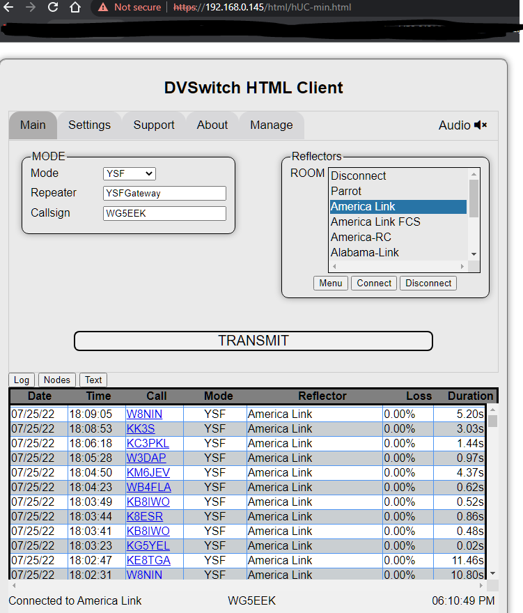
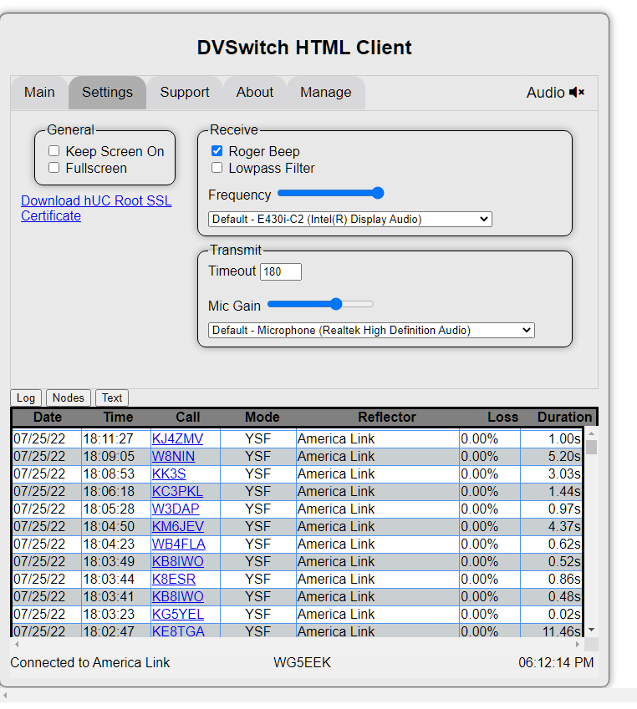

Slide 12
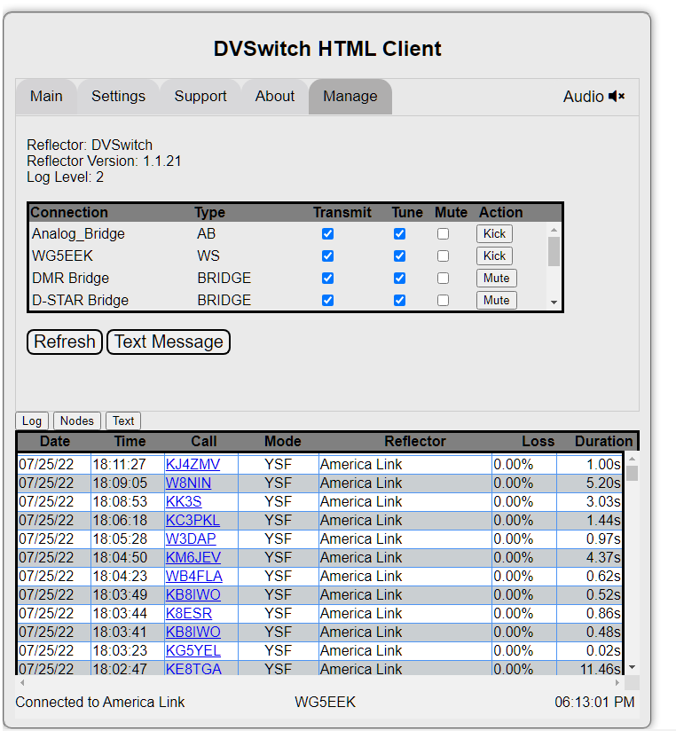

Slide 13
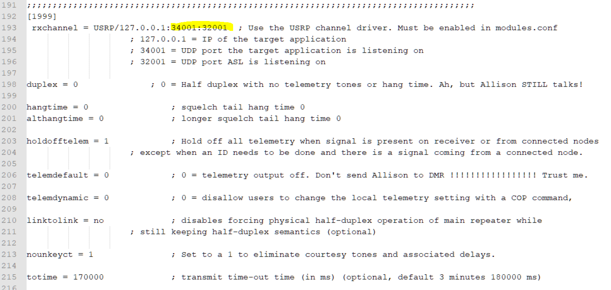
Analog_Reflector Bonus! Bridge to AllstarLink
Add/Replace 1999 Node Stanza right after your current Allstarlink Node Stanza, example: below [51010] in /etc/asterisk/rpt.conf
https://dvswitch.groups.io/g/allstarlink/wiki/9671 <- Node Example

Slide 14
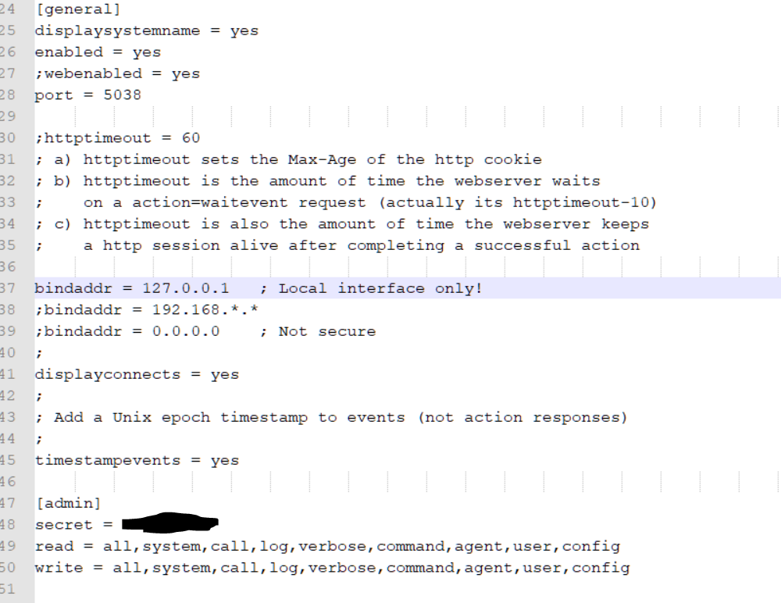
Doublecheck your manager.conf password is setup in /etc/asterisk/manager.conf

Slide 15
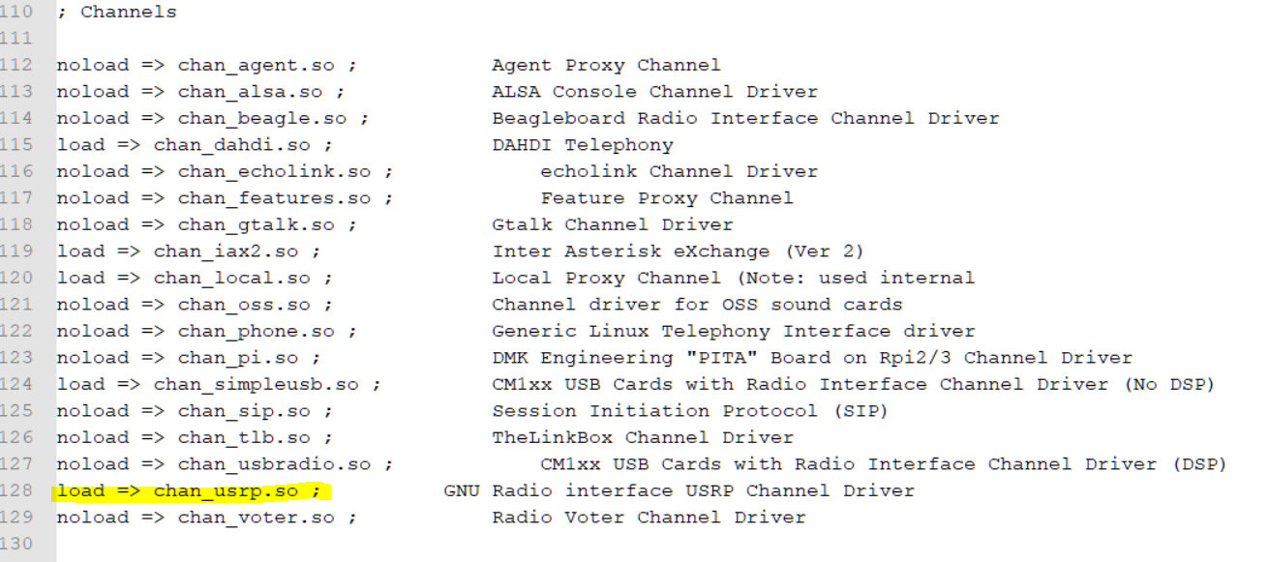
Analog_Relfector Bonus! Bridge to AllstarLink cont.
Enable USRP in modules.conf in /etc/asterisk/modules.conf
Change noload => chan_usrp.so to load => chan_usrp.so

Slide 16
Analog_Relfector Bonus! Bridge to AllstarLink cont.
Configure Analog_Reflector.json in /opt/Analog_Reflector/Analog_Reflector.json
amiSecret is the password from manager.conf under [admin]

Slide 17
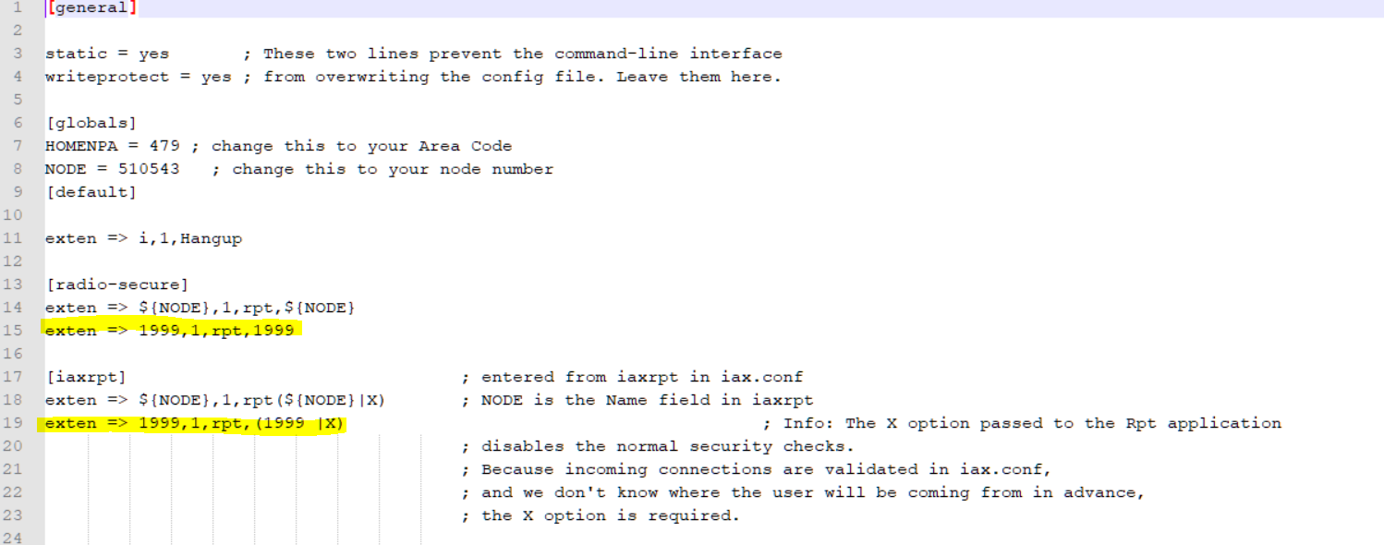
Analog_Relfector Bonus! Bridge to AllstarLink cont.
You should be able to connect to node 1999 from your main node but if it doesn’t work, you will have to add some lines in extensions.conf in /etc/asterisk/extentions.conf

Slide 18
Analog_Relfector Bonus! Bridge to AllstarLink Final
You can either restart Asterisk in bash via astres.sh or via Supermon if setup and installed via the RESTART Button, or via the restart asterisk option in asl-menu, > 9 System Diagnostics Menu, G Restart ASL Asterisk.
You may just want to reboot

Slide 19
Important Links
https://dvswitch.groups.io/g/Analog-Reflector/
https://dvswitch.groups.io/g/Analog-Reflector/files/Analog_Reflector.pdf
https://dvswitch.groups.io/g/allstarlink
https://dvswitch.groups.io/
https://news.brandmeister.network/configure-a-security-password-for-your-hotspots/
https://www.radioid.net/register#! <-Get a DMR ID

